Slide 1
Activity Diagrams
Resources
http://www.uml-diagrams.org/activity-diagrams-examples.html

Slide 2
Activity diagrams can be used to model higher-level business process at the business unit level, or to model low-level internal class actions.
Activity diagrams show the procedural flow of control between two or more class objects while processing an activity.
activity diagram is to model the procedural flow of actions that are part of a larger activity

Slide 3
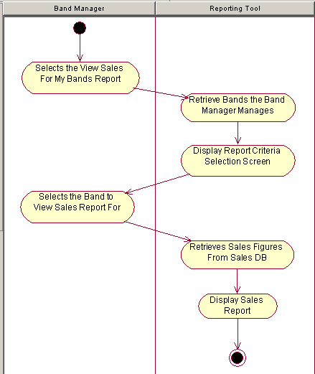
Activity diagram, with two swimlanes to indicate control of activity by two objects: the band manager, and the reporting tool

Slide 4
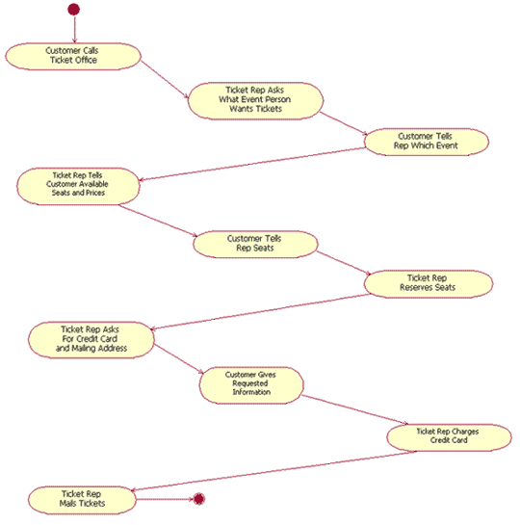
ACTIVITY DIAGRAM with NO SWIMLANES

Slide 5
"Booking a Concert Ticket," with actions in the following order:
1. Customer calls ticket office.
2. Ticket rep asks what event person wants tickets for.
3. Customer tells rep event choice.
4. Ticket rep tells customer available seats and prices.
5. Customer tells rep seating choice.
6. Ticket rep reserves seats.
7. Ticket rep asks for credit card and billing address.
8. Customer gives requested information.
9. Ticket rep charges credit card.
10. Ticket rep mails tickets.

Slide 6
Decision points
Typically, decisions need to be made throughout an activity, depending on the outcome of a specific prior action. In creating the activity diagram for such cases, you might need to model two or more different sequences of actions.
For example, when I order Chinese food for delivery, I call the
Chinese food delivery guy, give him my phone number, and his computer will automatically display my address if I've ordered food before.
But if I'm a new customer calling for the first time, he must get my address before he takes my order.
The UML specification provides two ways to model decisions

Slide 7
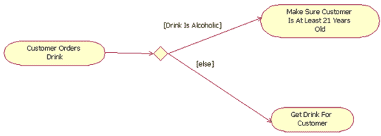
The first way is to show a single transition line coming out of an action and connecting to a decision point.
each transition line involved in a decision point must
be labeled with text above it to indicate "guard conditions," commonly
abbreviated as guards.

Slide 8
Guard condition text is always placed in brackets -- for example, [guard
condition text].
A guard condition explicitly tells when to follow a transition line to the next action. According to the decision point shown in Figure a
bartender (user) only needs to "make sure the customer is at least 21
years old" when the customer orders an alcoholic drink.
If the customer orders any other type of drink (the "else" condition), then the bartender simply gets the drink for the customer.
The [else] guard is commonly used
in activity diagrams to mean "if none of the other guarded transition lines matches the actual condition," then follow the [else] transition line

Slide 9
Merge points
Sometimes the procedural flow from one decision path may connect back to another decision path, as shown in Figure 6 at the "Customer's Age > = 21" condition.
In these cases, we connect two or more action paths
together using the same diamond icon with multiple paths pointing to it, but with only one transition line coming out of it.
This does not indicate a decision point, but rather a merge.

Slide 10
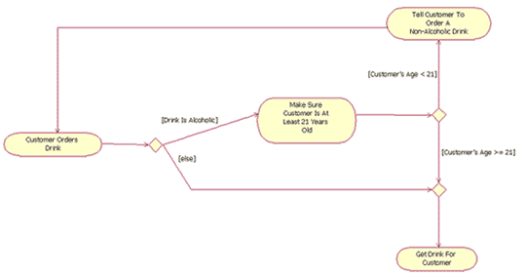
A partial activity diagram, showing two decision points
("Drink is alcoholic" and "Customer's age < 21")
and one merge ("else" and "Customer's age >= 21")

Slide 11
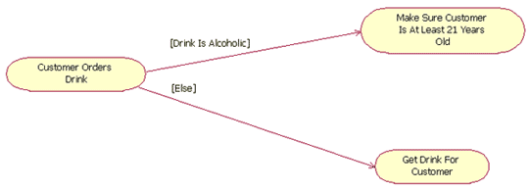
The second approach to modeling decisions is to have multiple transition
each transition line coming out of the action must have a guard label above it,
as with decisions (i.e., the diamond symbols) in the first approach.
All the rules that apply to the decision symbol apply to decisions that are modeled out of an action

Slide 12
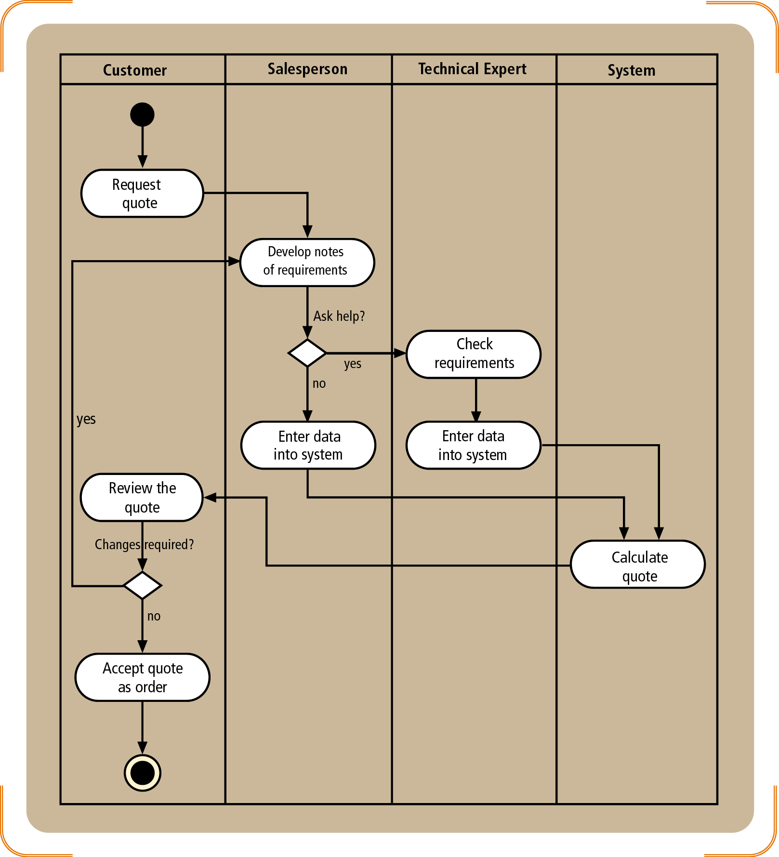
Activity Diagram to document the workflow for
Insurance Quote Generation:
Simple Case: Salesperson generates the quote
Complex cases: needs help from technical experts

Slide 13
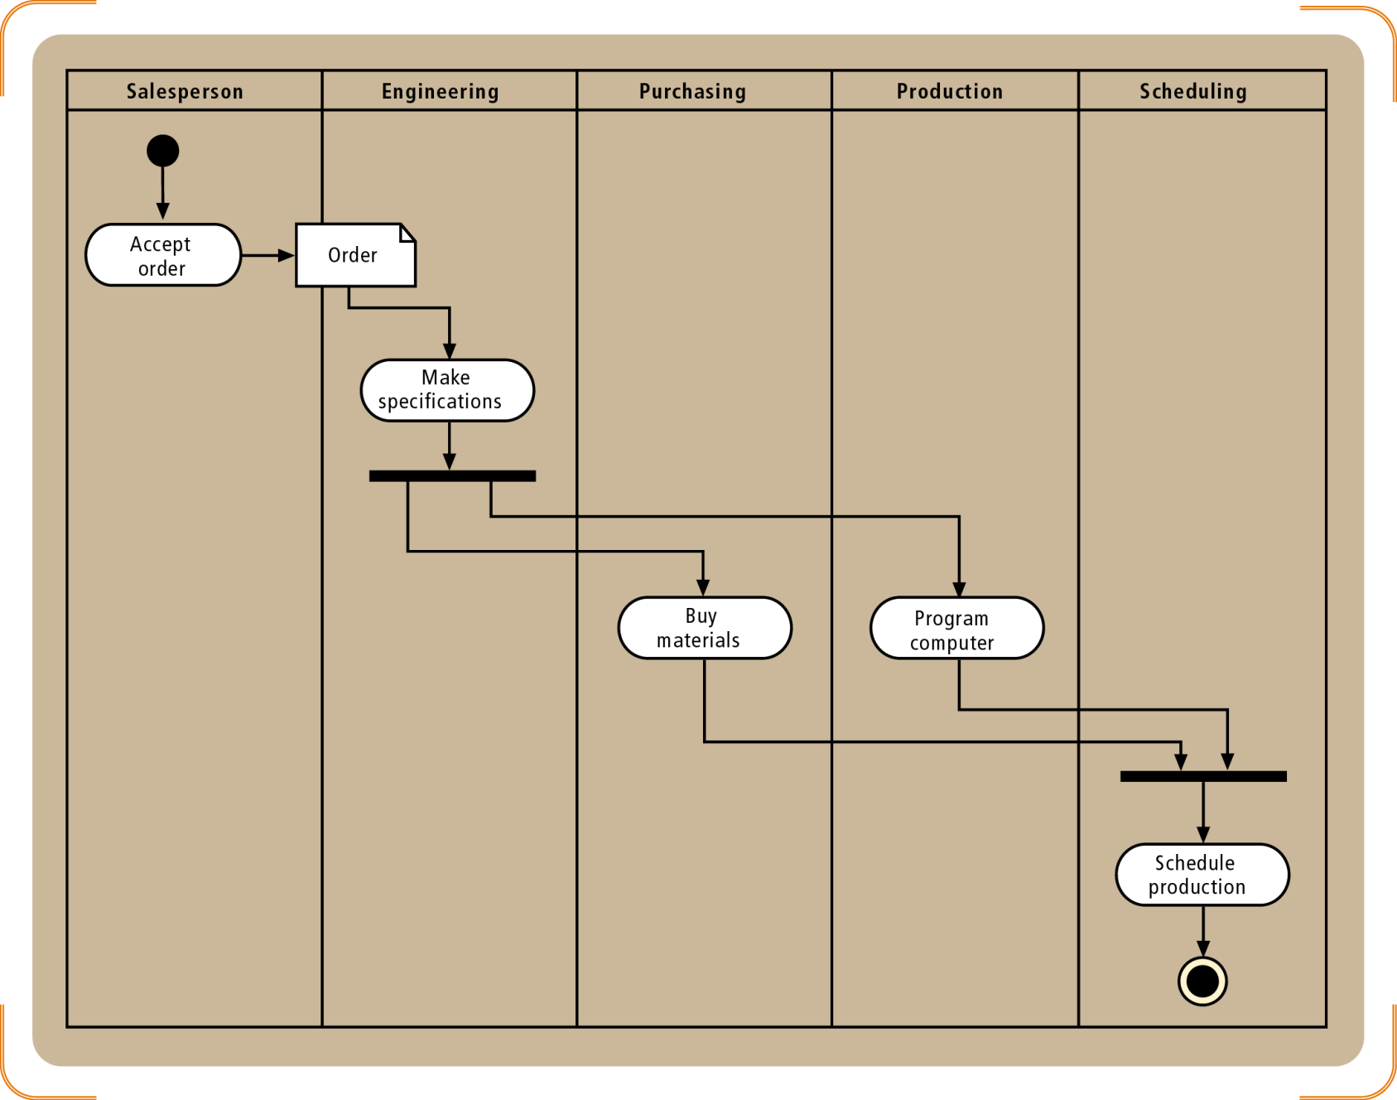
Activity Diagram for
Order Production
Concurrent Paths with a synchronization bar

Slide 14
Activity Diagram is a representation of workflow
Identify agents to create the appropriate swim-lanes
Represent steps of workflow with appropriate ovals
Connect activity ovals with arrows to show direction
Use decision symbol to represent either/or situation
Use synchronization bars for parallel paths

